Slide 1
Speech-to-Text Notes App
Cassidy Sakamoto, Nathan Tan, and Justin Glabicki
EECE 2140
Dr. Fatema Nafa

Slide 2
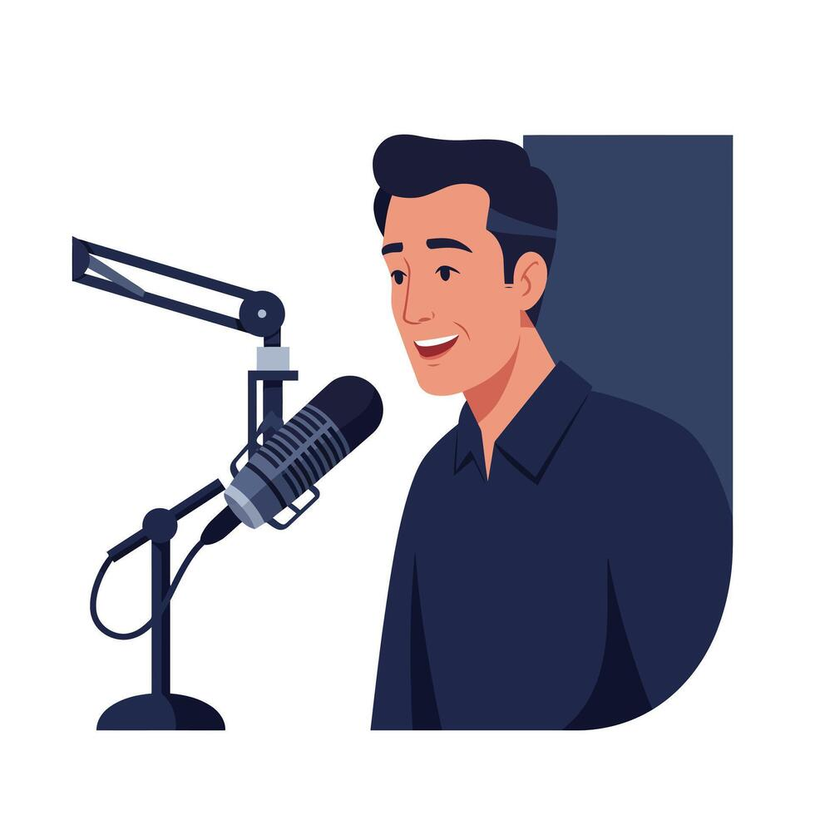
Project Scope
General
  Capture speech through microphone input
  Convert speech to text using Python libraries
  Provide an interactive UI for users
Specific
  Implement start/stop recording
  Save notes with timestamps and metadata
  Add keyword and phrase search for saved notes
  Allow note filtering by date or topic tags
  Export notes to TXT or Markdown
  Include noise gate and mic-level meter
  Add settings for recording customizability
  Add error handling

Slide 3
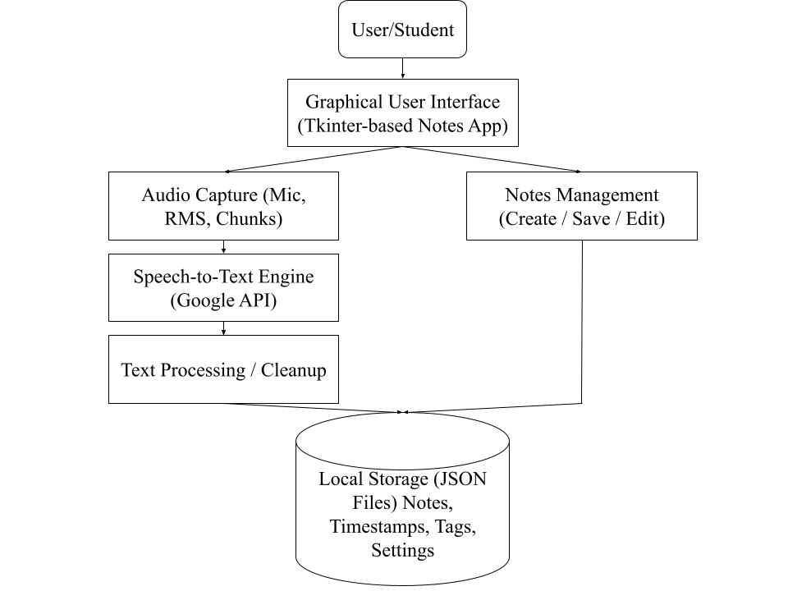
System Overview

Slide 4

Tools Used
Core Tools & Libraries Used
  sounddevice - Real-time microphone input and audio streaming
  numpy - Audio processing, RMS loudness calculation
  speech_recognition (Google API) - Cloud-based speech-to-text
  threading - Background transcription without freezing UI
  json + pathlib - Local storage for notes, settings dictionary
  dataclasses - Structured note objects
  uuid - Unique ID generation for notes
User Interface
  tkinter/ttk - GUI framework
  filedialog - Export notes (.txt, .md)
  messagebox - Save/delete notifications
Utilities
  time - Timing, timestamps, autosave
  struct - Converting audio arrays to PCM bytes
  typing - Type hints for cleaner code design

Slide 5
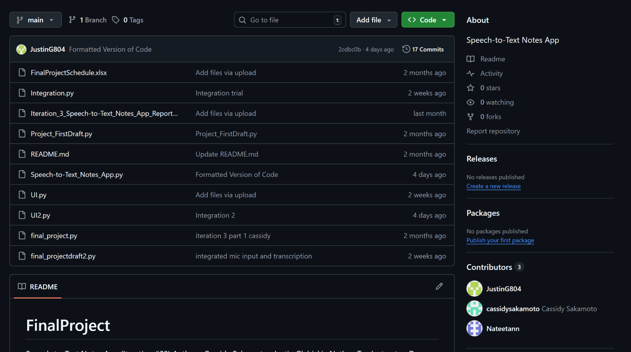
GitHub

Slide 6
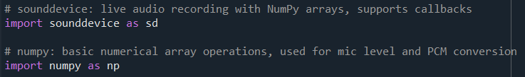
Backend - Microphone input
Overview:
MicrophoneInput class uses sounddevice library to take in audio, processes the audio (sends level to UI, etc.), and allows the rest of the program to receive and transcribe small chunks of audio
Notes:
Workflow:
Microphone input class
How audio callback function calls the process_audio function
Explain how backend is integrated into UI
In App.__init__()... self.mic = MicrophoneInput( )

Slide 7
Backend - Microphone input
__init__ constructor:
Initializes RMS noise gate threshold, sample rate (48kHz), chunk duration (20ms), and samples per chunk (960 samples per 20ms chunk)
Audio callback function:
Converts audio into 1D NumPy array
Calculates RMS of volume and prints mic level meter using RMS
Updates mic level meter in UI (level_callback)
Sends audio to transcription part of code (self.callback(audio_chunk) calls process_audio function)
In UI…
Notes:
Workflow:
Microphone input class
How audio callback function calls the process_audio function
Explain how backend is integrated into UI
In App.__init__()... self.mic = MicrophoneInput( )

Slide 8
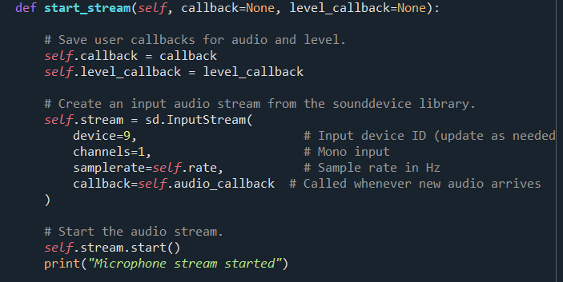
Backend - Microphone input
start_stream()
UI - called when user clicks “Start Recording”
Saves callbacks
Creates mic input stream using sounddevice library (to call audio_callback every 20ms)
stop_stream()
UI - called when user clicks “Stop”
If mic stream is running, stop it
Notes:
Workflow:
Microphone input class
How audio callback function calls the process_audio function
Explain how backend is integrated into UI
In App.__init__()... self.mic = MicrophoneInput( )

Slide 9

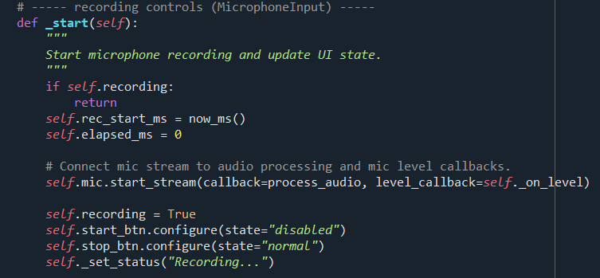
Integration
Mic object created in App.__init__(); creates MicrophoneInput with set threshold (0.002) and sample rate (48kHz) values
Bringing MicrophoneInput class into App class
Calling mic.start_stream()

Slide 10

Backend - Speech-to-Text Pipeline
Overview:
The transcription pipeline converts audio chunks from microphone into readable text
Uses speech_recognition library with Google Speech API for cloud-based recognition
Implements robust error handling with retry logic and text post-processing
Integration:
Receives 20ms audio frames from MicrophoneInput
Aggregates frames into 6-second chunks for API efficiency
Returns transcribed text to UI via thread-safe callback

Slide 11
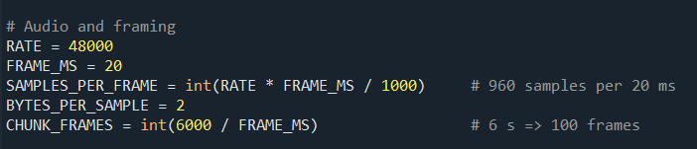
Frame Aggregation
API Efficiency: Reduces number of expensive cloud API calls
User Experience: Text appears every 6 seconds, not too slow
Complete Phrases: Long enough to capture natural speech segments
Memory: Manageable buffer size (300 × 960 × 2 = ~576 KB per chunk)

Slide 12
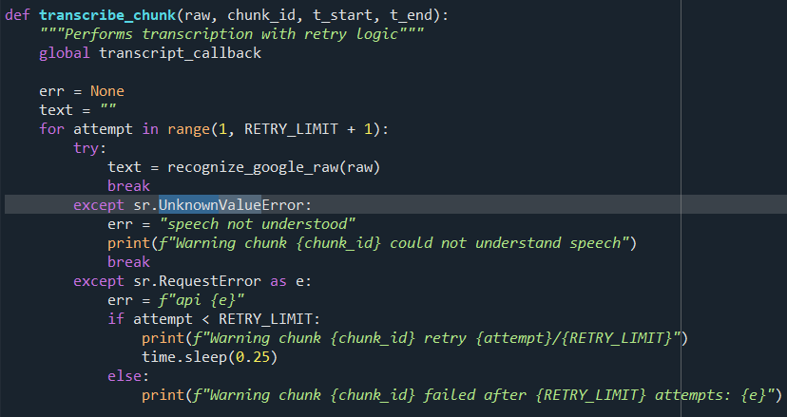

Error Handling & Retry Logic
Error Types:
UnknownValueError:
Bad audio quality
RequestError:
Network issues, retry up to 3 times
Graceful Degradation: Returns empty string if everything failed

Slide 13
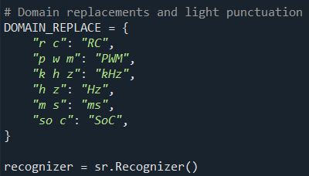
Domain-Specific Normalization
The Problem:
General STT misrecognition on engineering terms
Example:
“p w m” instead of “PWM”
“k h z” instead of “kHz”
Missing punctuation
Example Run:
Input: “the p w m signal runs at 20 k h z”
Output: “The PWM signal runs at 20kHz.”

Slide 14
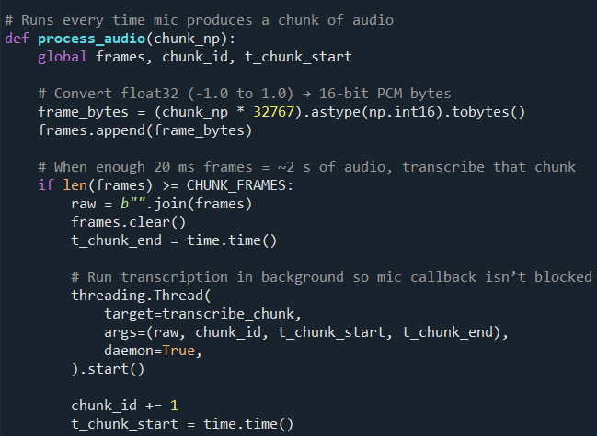
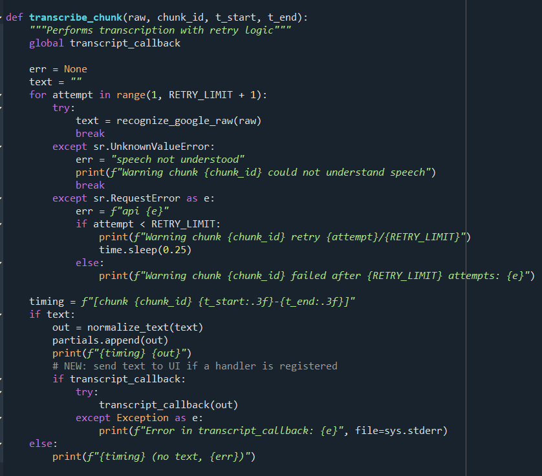
Threading & Integration
Google API calls take 500ms - 2 seconds
Blocking main thread would freeze UI completely
Background processing keeps interface responsive

Slide 15
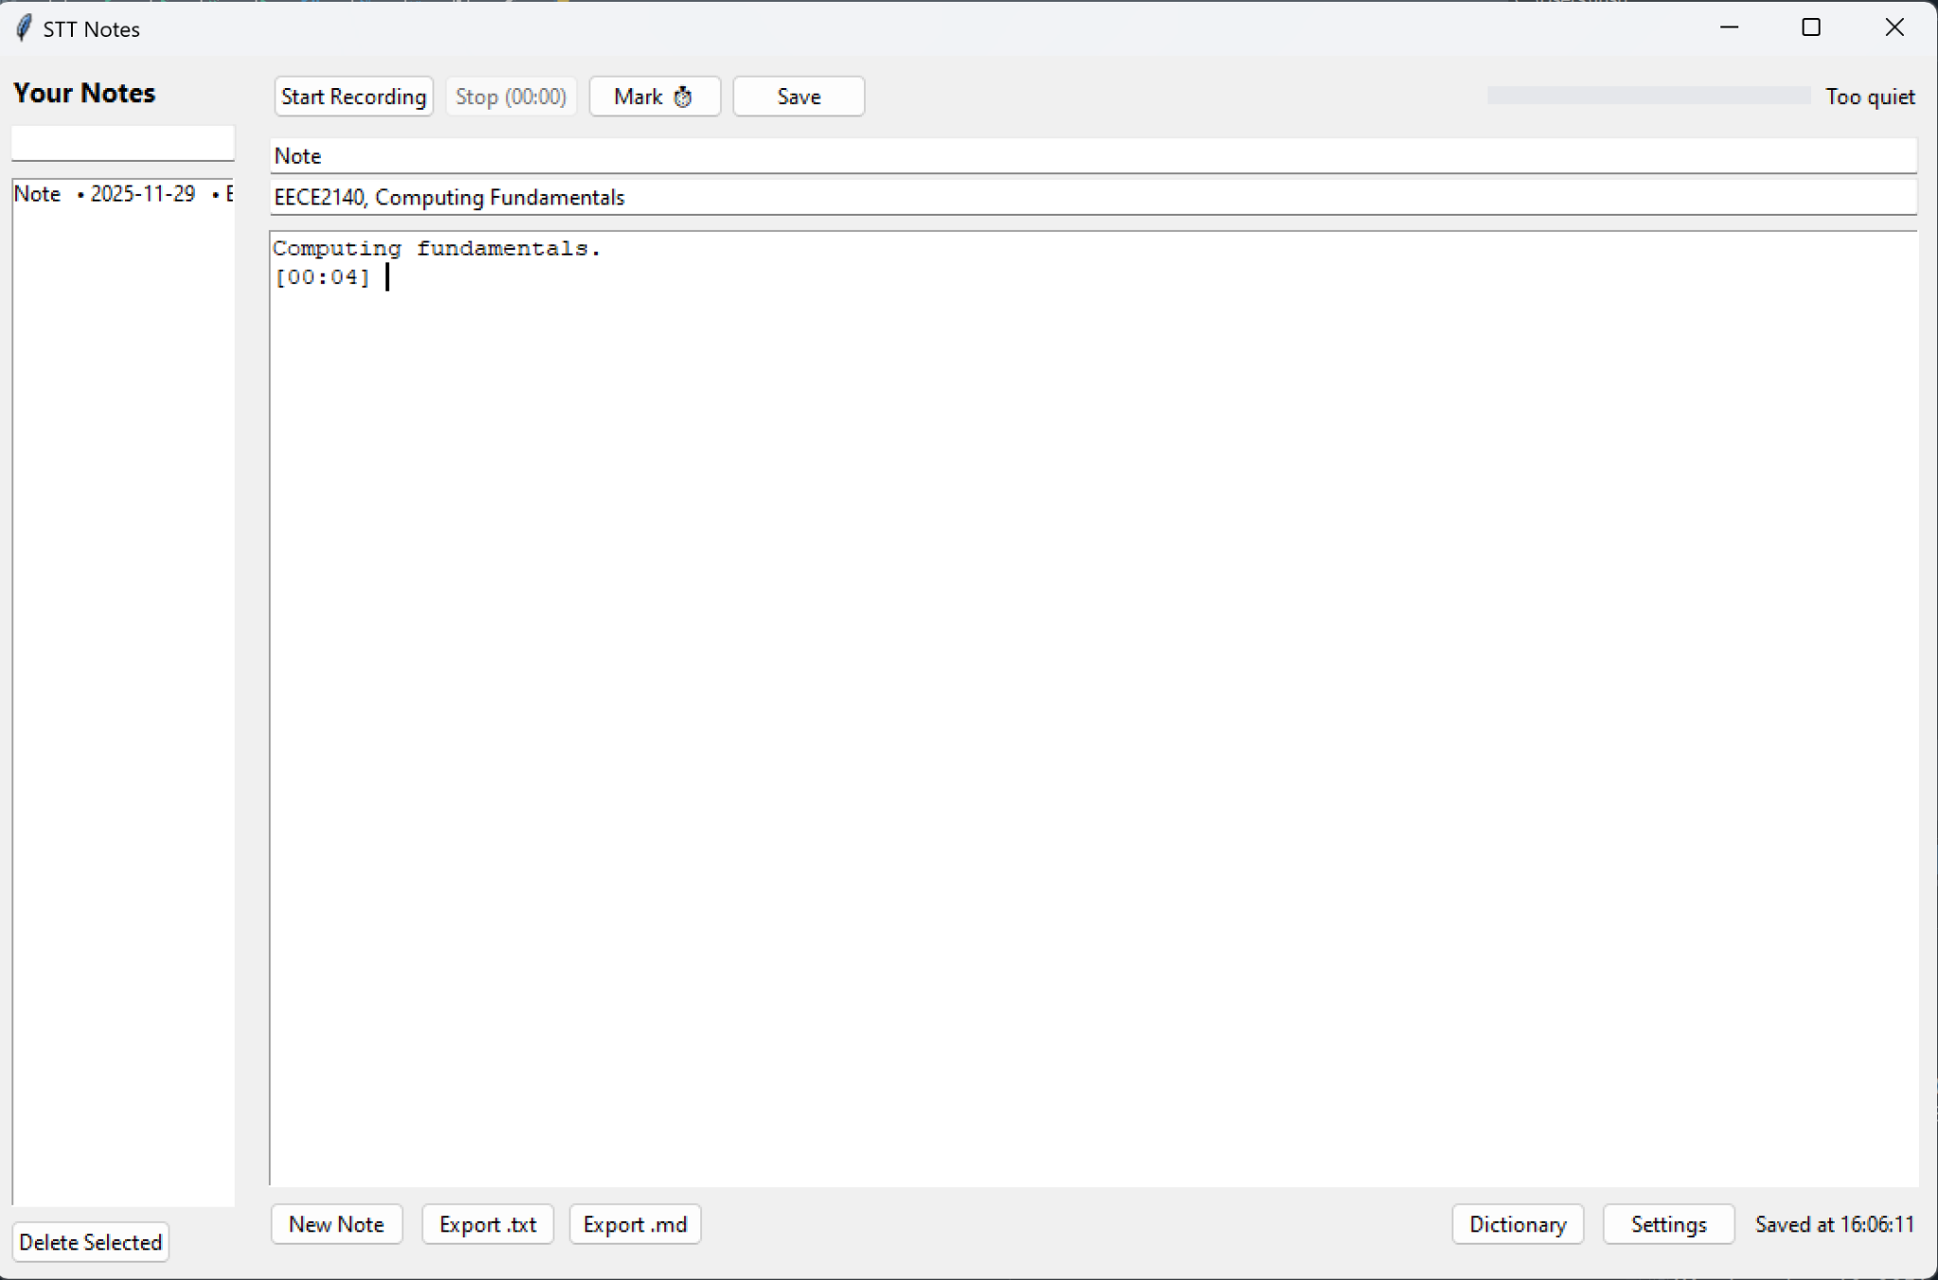
UI Overview
Purpose of the UI
  Provide an interface to record, view, edit, and export notes
  Display live microphone level
  Manage local notes and settings
Key UI Components
  Sidebar: search + list of notes
  Main panel: title, tags, text editor
  Recording controls: Start, Stop, Timestamp
  Level meter (RMS visual indicator)
  Settings + Dictionary Panels
  Local JSON storage integration

Slide 16
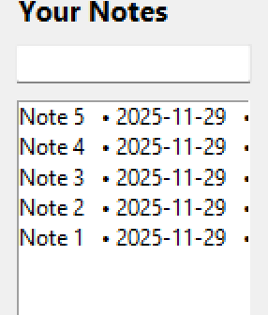




UI Architecture & Workflow
Architecture Highlights
  UI implemented with Tkinter + ttk
  App class manages:
    Notes list
    Mic input
    Transcription callback
    Autosave + timers
    User interactions
Workflow
User clicks Start Record
Mic stream feeds chunks -> backend
Transcription text returned via callback
UI inserts text live into the editor
Notes can be saved, searched, tagged, deleted, and exported
Continuous Update Loop
  _ui_tick() runs every 100 ms to update
    Level meter
    Recording timer
    Autosave logic

Slide 17
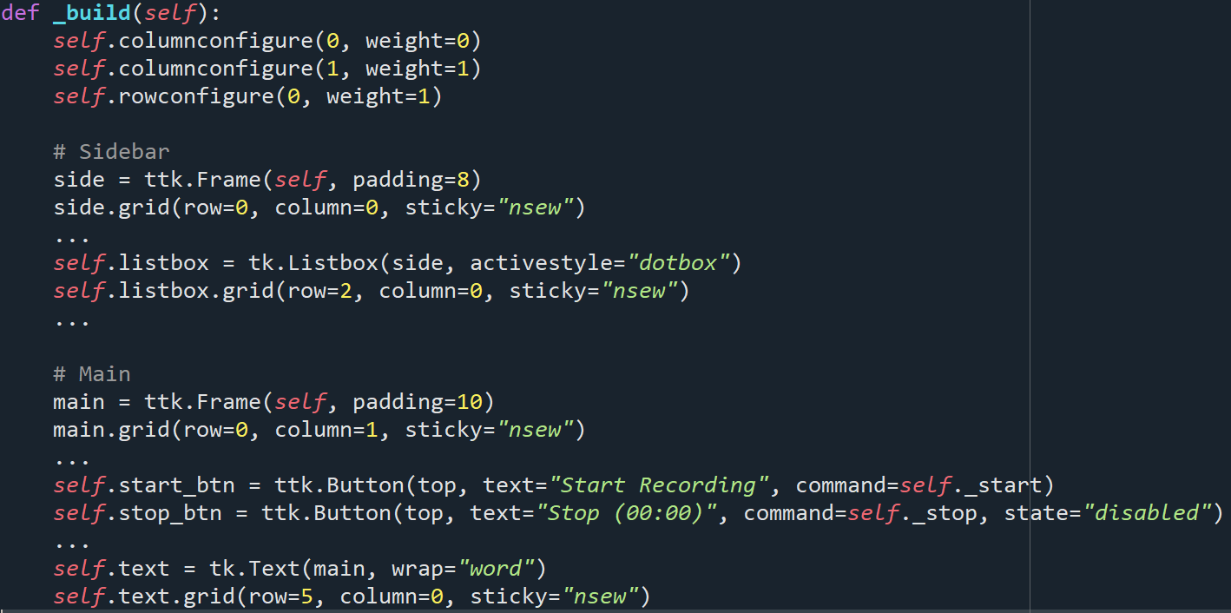
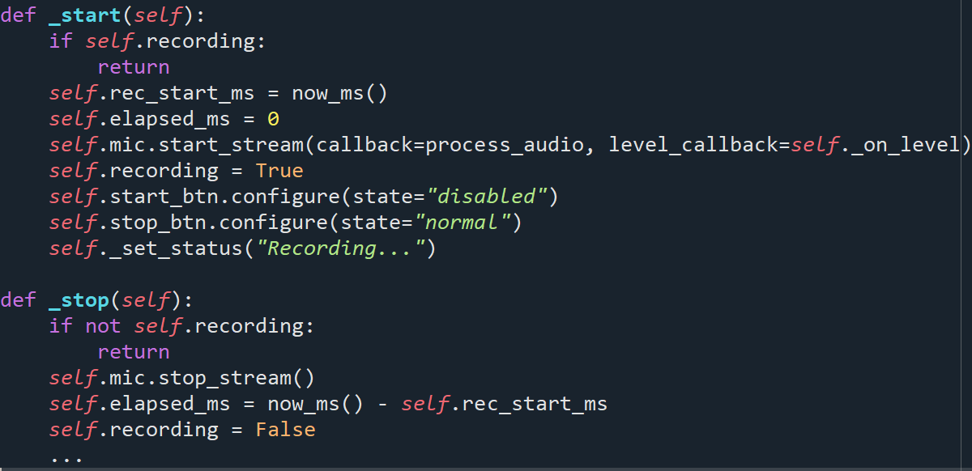
UI Architecture & Workflow (Code)

Slide 18
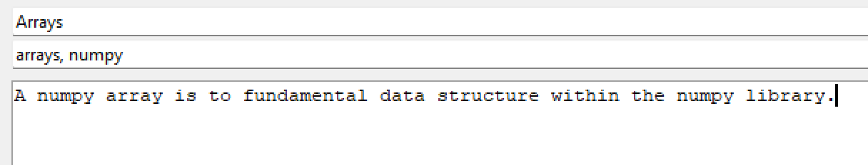


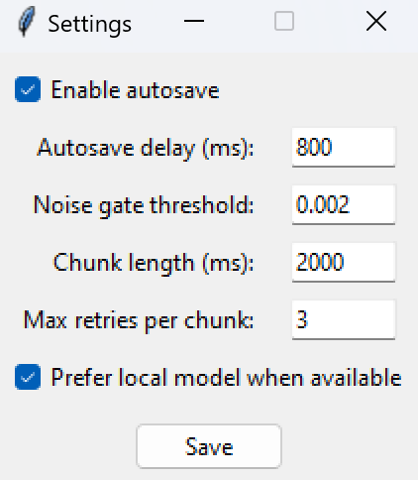
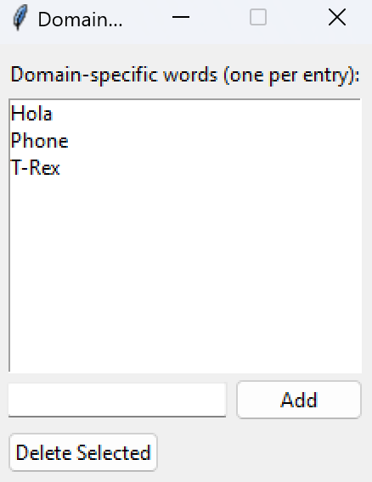
Note Management and Additional Features
Note Management
  Create, edit, delete notes
  Autosave after user pauses typing
  Notes stored in notes.json
  Search bar filters notes by title/content/tags
  Export to .txt or .md
Additional UI Tools
  Settings window (autosave delay, noise gate, chunk length)
  Dictionary window (domain-specific words)
  Status bar feedback (recording state, saved times, errors)
Backend Connection
  UI receives STT text through a thread-safe callback
  Ensures smooth, non-blocking updates during recording

Slide 19
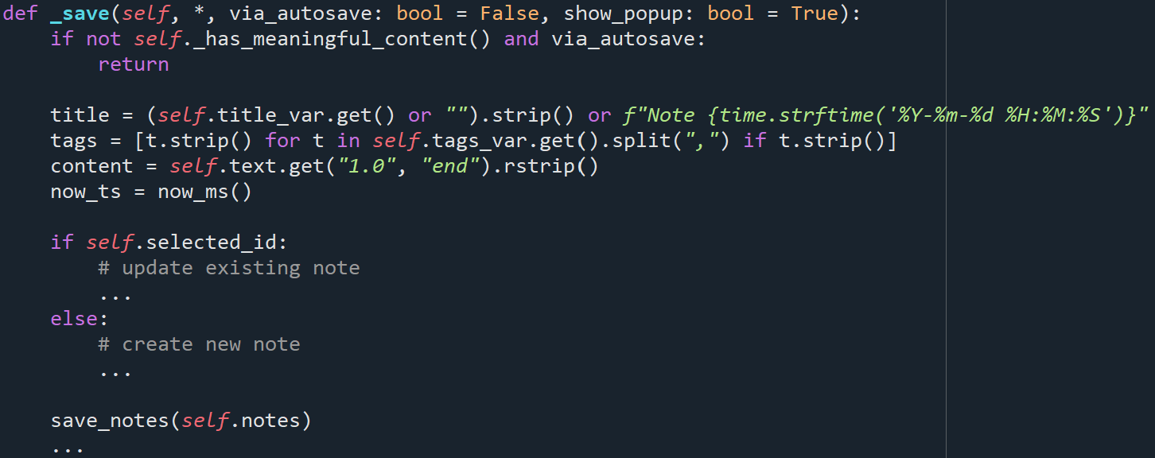
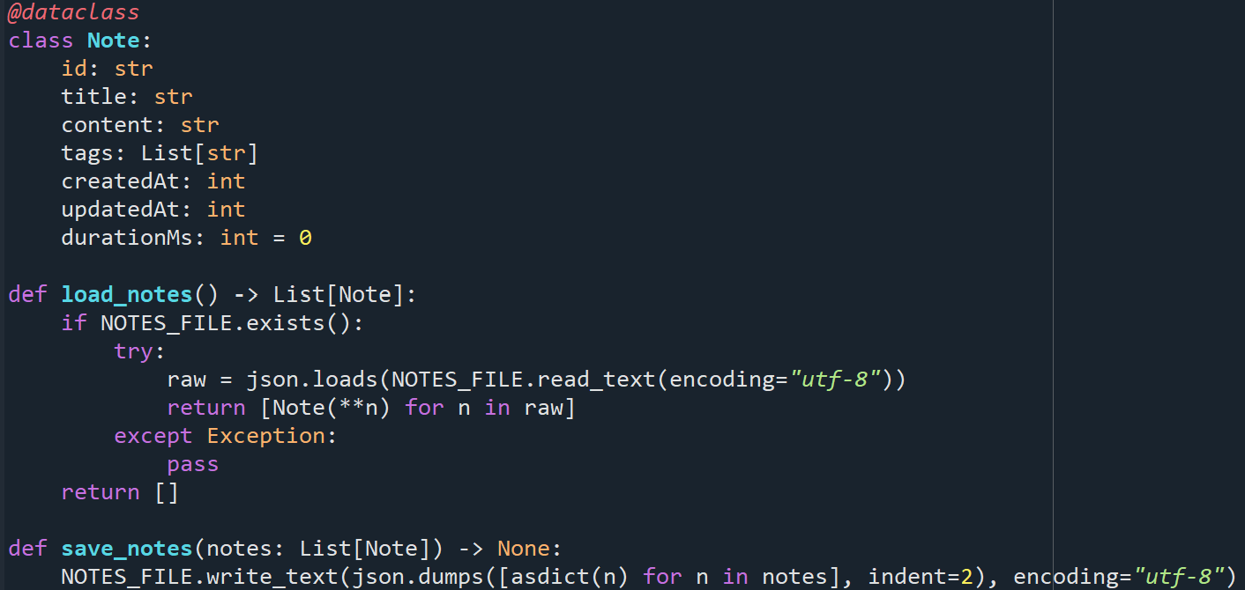
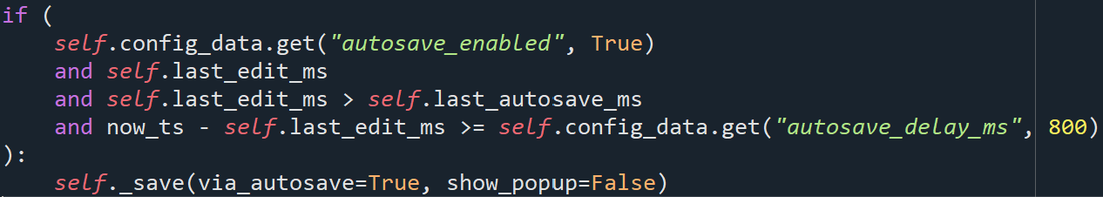
Note Management and Additional Features (Code)

Slide 20
Demo

